Slide 1
Design Proposal
Group：Five Fingers
Jing Zhang
Xueyang Wang
Christina Mary
Parvathy Rajeev
Mugdha Prasad Kamalakar
Domain: Having fun during the travelling

Slide 2


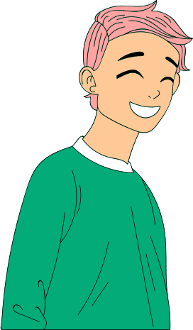

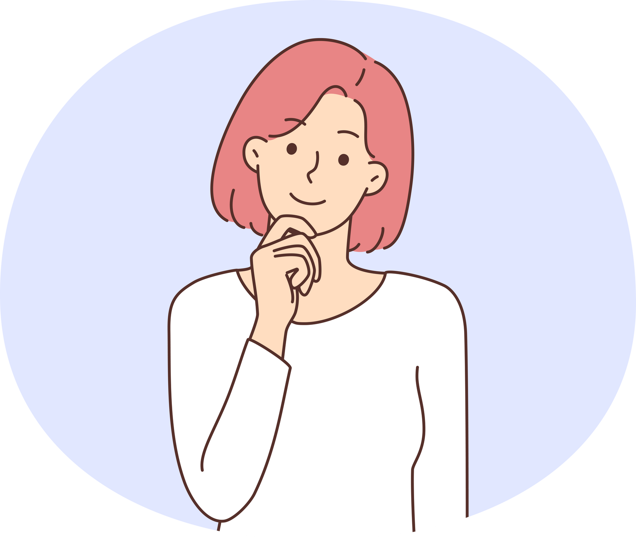
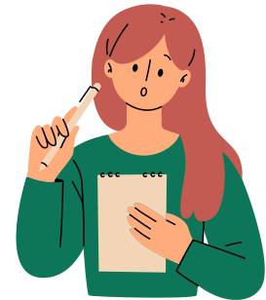



Group Five Fingers
Jing Zhang
Xueyang Wang
Christina Mary
Parvathy Rajeev
Mugdha Prasad Kamalakar
Our background comes with a diversified strengths, where each member showcases their unique skill sets that include Knowledge based skills such as
Interaction Design, UI Design, UX Design,
Innovative Solutions.
Followed with Interpersonal skills such as listening, communication and accountability.
Our Strengths

Slide 3

Domain: Having fun during the travelling
"Our Solution Aims to Simplify Social Travel Planning by Tackling These Core Challenges."
Main problem：
Difficulty Finding Compatible Travel Companions
Challenges in Planning Group Activities and Itineraries
Lack of Tools for Enhancing Social Interactions During Travel
Coordinating Diverse Preferences and Interests
Ensuring Safety and Trust When Meeting New People
Insights from Interviews
Difficulty buying tickets for attractions
Challenges with public transportation in unfamiliar cities
Language barriers
Project Goal
Our project aims to develop a solution that simplifies travel planning, facilitates finding compatible companions, and enhances social interactions, making travel more enjoyable and less stressful.

Slide 4
Design opportunity &
Audiences
Design Opportunity
Enhanced UI/UX
Simplifying the overall travel exp- Addressing challenges while booking tickets
Help users with language support
Connect with others based on their online activity
Audience
Solo trippers
Students looking for a travel companion
People who finds planning tedious

Slide 5
Concepts &
Previous Attempts
Previous Attempts
Travello - The app is kind of like a social media platform where people can share pics of the places they visit. Also allows the users to chat with other users.
City Mapper - Main issue found is complex navigation pattern align with it the app shows only limited locations, mostly prominent cities.
Road Tripper - Mainly for road tripping, it is mostly useful for families or friend groups who want to go for a day trip.
Concept
Travel app for planning trips and meeting like minded people.
In the proposed design, we have added a feature where the users can ask out other users based on their availability.
In order to provide smooth navigation of the application, the interactions are kept simple and familiar icons are being used.
The app will provide language support to foreign speakers.
It helps the users to navigate through unfamiliar cities.

Slide 6
Plan for work
1.Research and Insights Gathering
Conduct Interviews: Continue gathering insights from potential users to better understand their pain points, particularly around buying tickets, navigating public transportation, and language barriers.
Analyze Existing Solutions: Evaluate existing apps like Travello, City Mapper, and Road Tripper to identify their strengths and shortcomings.
2.Design and Prototyping
User Interface (UI) and User Experience (UX) Design: Focus on creating an enhanced UI/UX that simplifies the overall travel planning experience. This will involve designing intuitive navigation patterns and incorporating language support.
Concept Development: Refine the app concept based on user feedback, ensuring that it allows users to connect with like-minded individuals and facilitates smooth planning.
3.Development
Feature Implementation: Begin by developing core features such as user matching for compatible travel companions, itinerary planning tools, and social interaction enhancers.
Testing and Iteration: Implement a cycle of user testing and iteration to ensure that the features meet user needs and provide a seamless experience.
4.Evaluation
Beta Testing: Launch a beta version of the app to a small group of users and collect feedback on usability and functionality.
Refinement: Address any issues identified during beta testing and refine the app accordingly.

